Slide 1
ARTIFICAL INTELLIGENCE PROJECT PRESENTATION
RESUME MANAGER

Slide 2
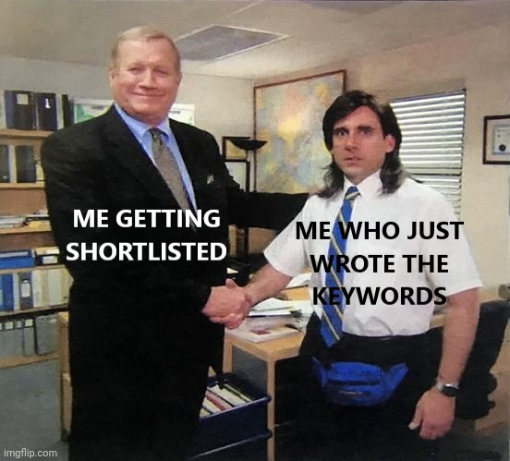
DRAWBACKS

